Slide 1
Real-time Filtering and ECG Signal Processing Based on Dual-Core Digital Signal Controller System
NGOC THANG BUI

Slide 2
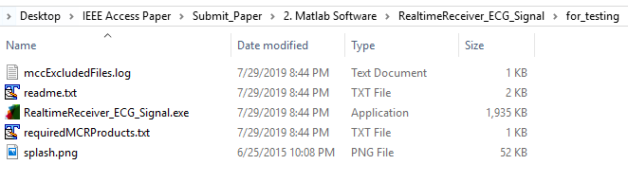
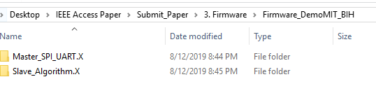
What is inside folder follow manuscript?
Software display ECG signal before and after filter
Firmware for master core
Firmware for slave core

Slide 3
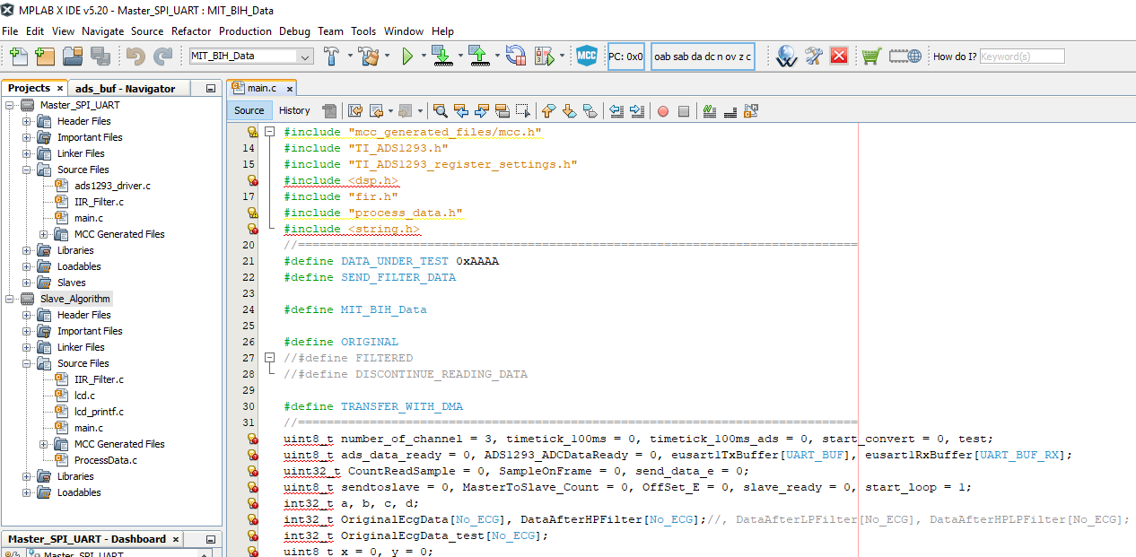
EXPLAINNING THE FIRMWARE

Slide 4
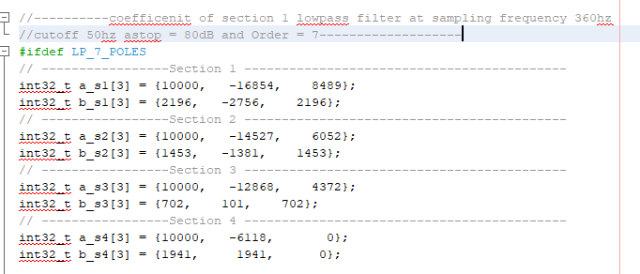
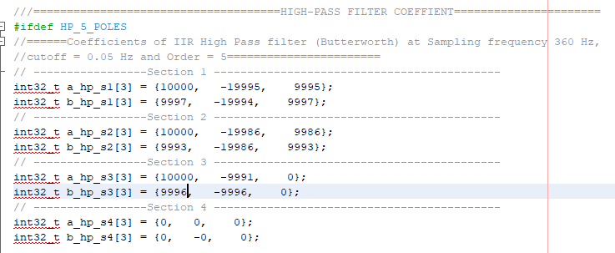
EXPLAINNING THE FIRMWARE
Coefficients of IIR low-pass filter inside slave core
Coefficients of IIR high-pass filter inside master core

Slide 5
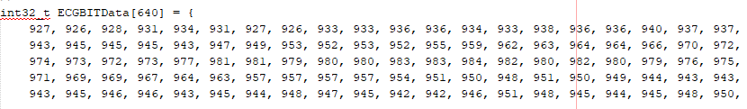
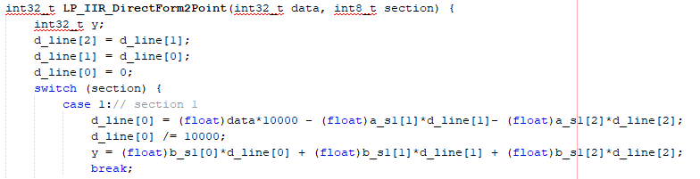
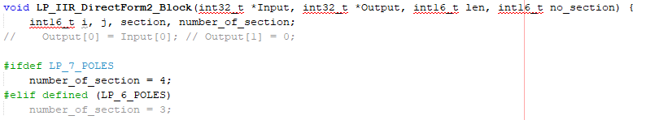
EXPLAINNING THE FIRMWARE
Samples data from MIT/BIH inside the firmware on master core
Filter point function
Filter block function

Slide 6
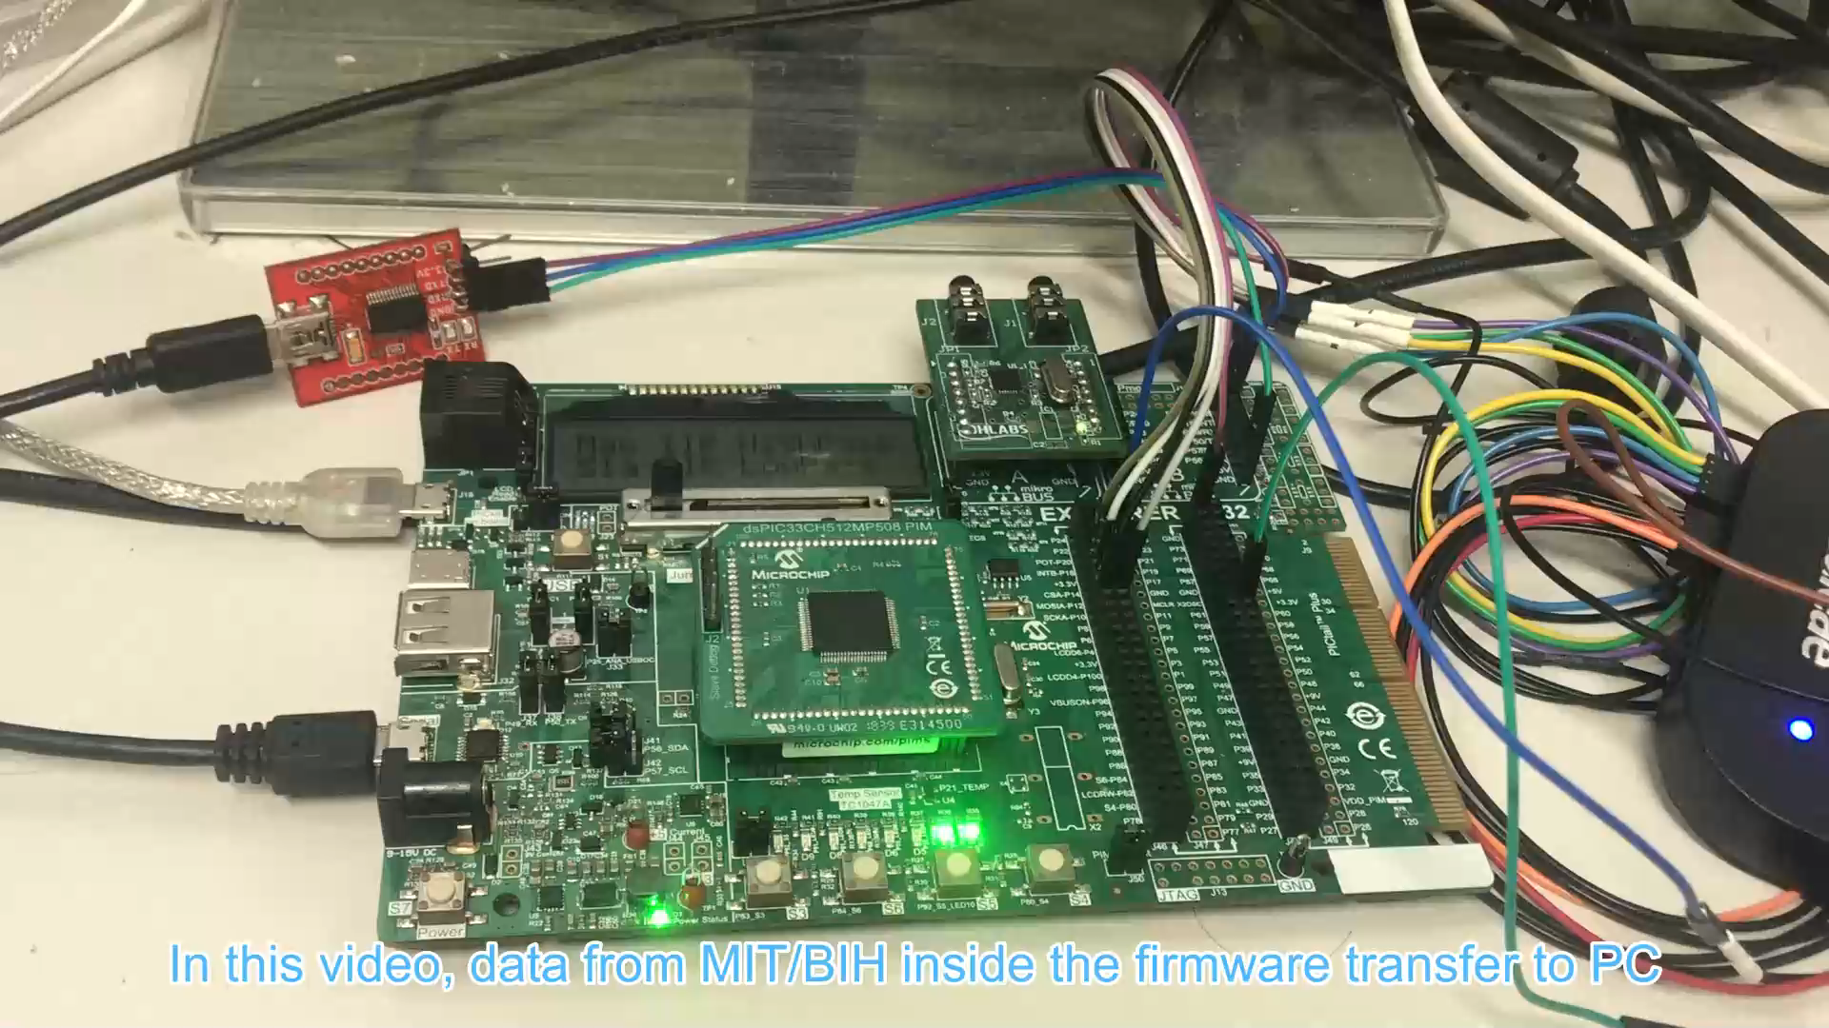
DEMO REAL-TIME FILTERING WITH MIT/BIH DATA

Slide 7
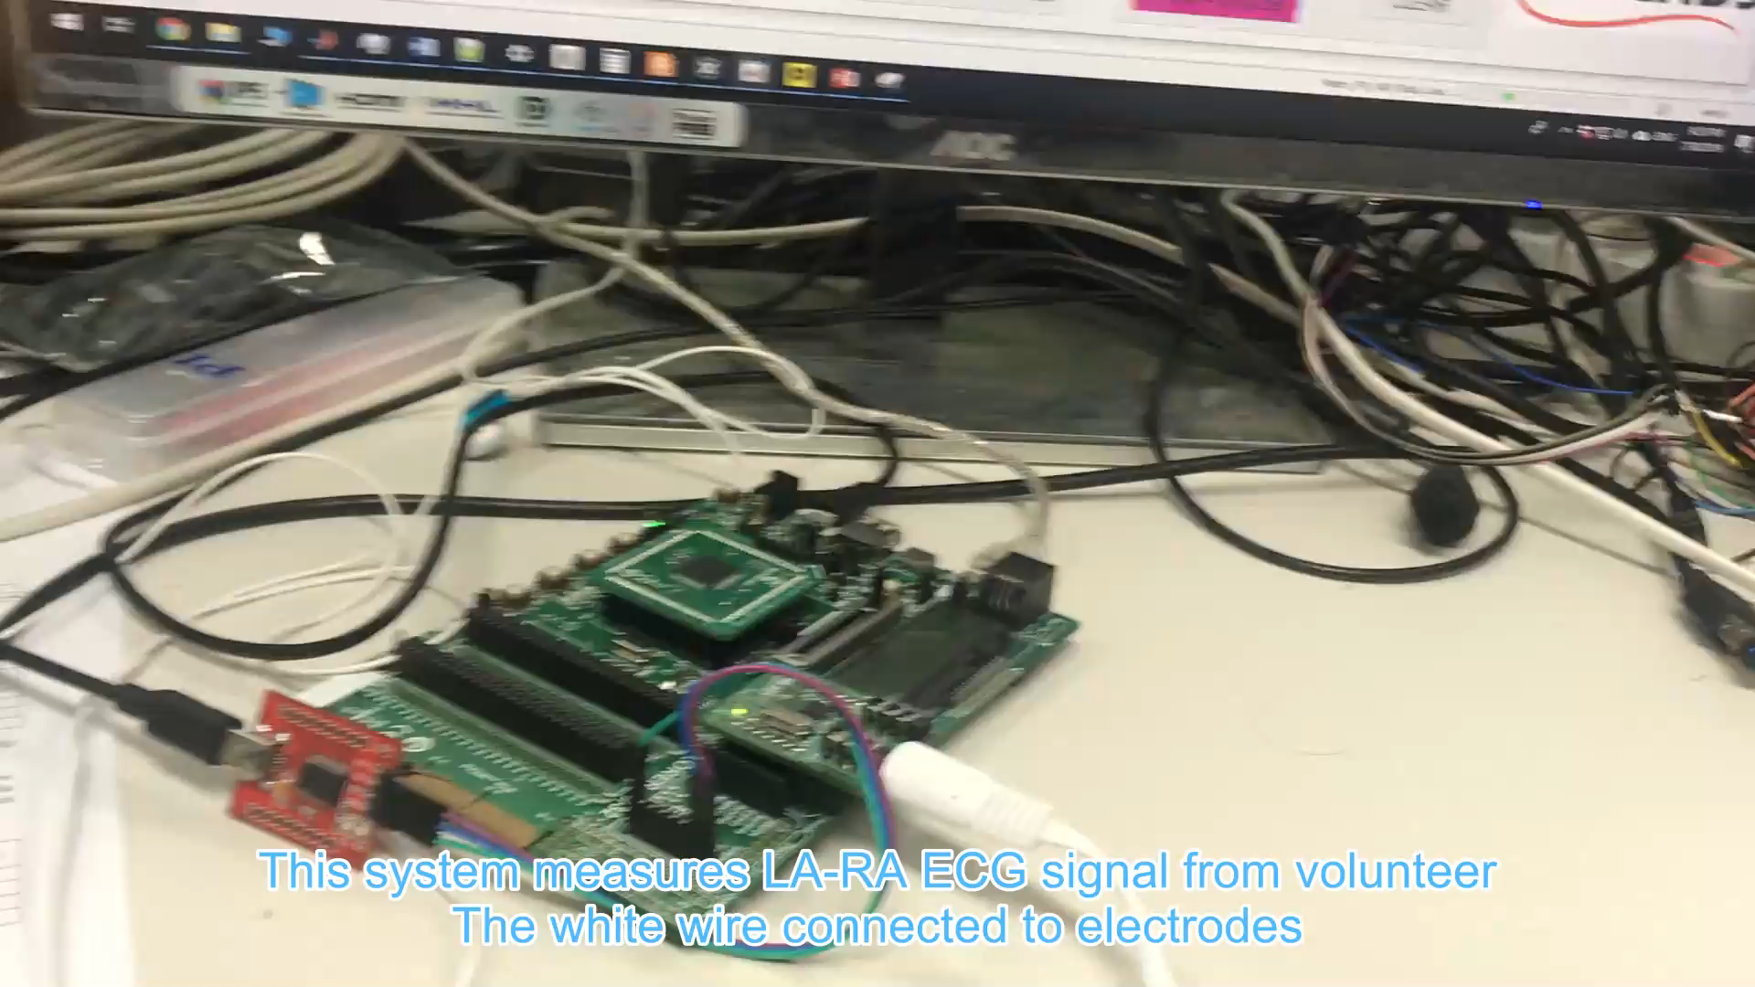
DEMO1 REAL-TIME FILTERING WITH REAL ECG SIGNAL

Slide 8
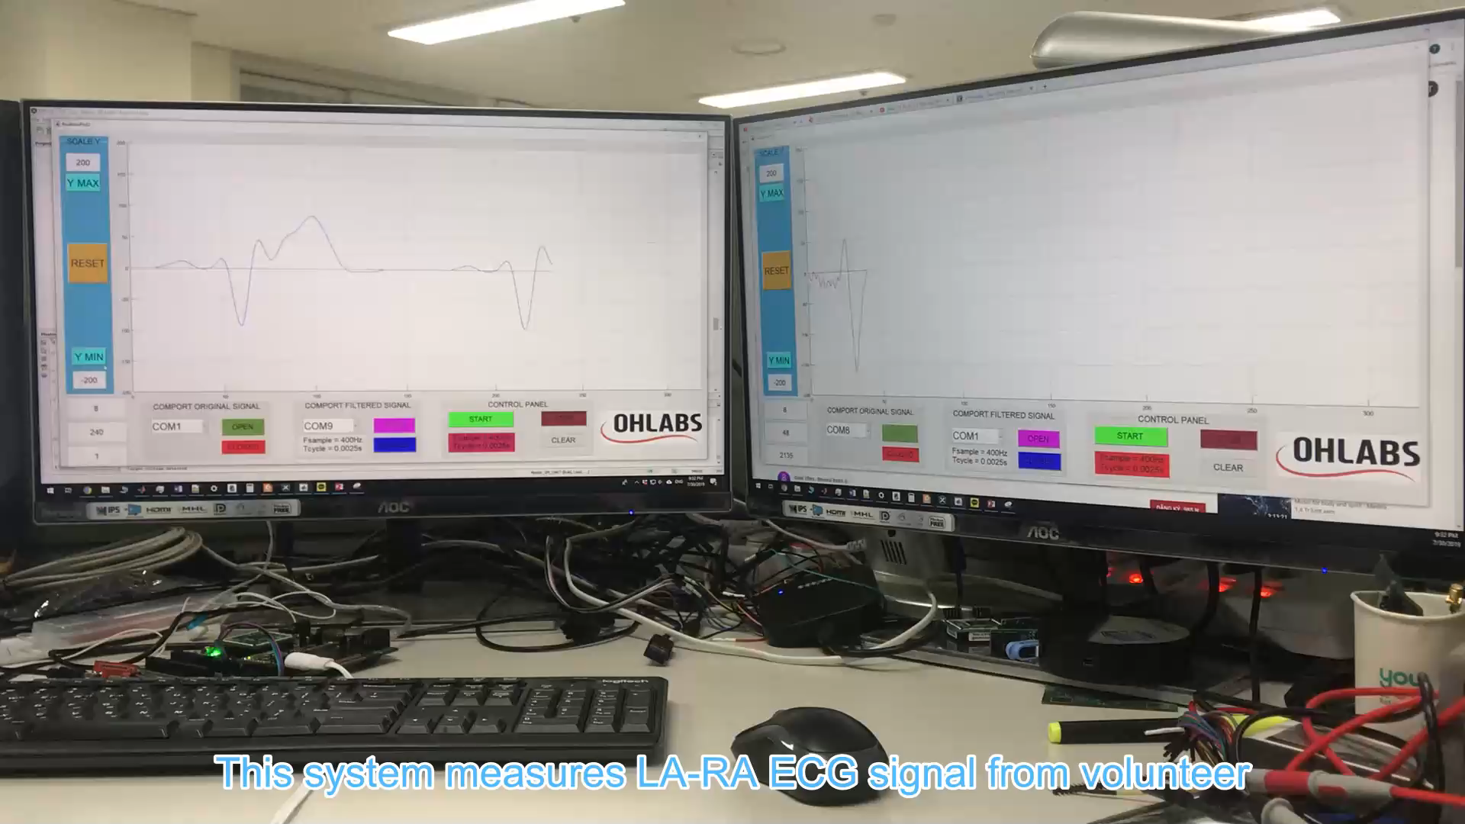
DEMO2 REAL-TIME FILTERING WITH REAL ECG SIGNAL

Slide 9
Thank you for your watching!

